Slide 1

Beginner programming Lesson
How to Use EV3Lessons

Slide 2
SITE oVERVIEW
EV3Lessons.com provides the building blocks for successfully learning to program the LEGO MINDSTORMS EV3
We also provide extensive resources for robotics teams such as planning tools, Quick Guides, Coach’s Corner and Team Building Activities
Anyone is welcome to use and modify these lessons for educational (non-profit) purposes
However, you must give credit to EV3Lessons for the materials and provide a link back to us if you post materials online
If you use EV3Lessons materials in any robotics competition (e.g. FIRST, WRO), you must cite your sources in your contest materials.
If you make extensive use of our materials, please consider making a donation to the site to support our work

Slide 3
LESSON DESCRIPTION
http://ev3lessons.com/lessons.html
Beginner: These lessons will teach you to move and turn the robot, use the sensors, and use loops and switches.
Intermediate: These lessons introduce more advanced programming techniques such as My Blocks, variables, parallel beams, calibration and math/logic blocks.
Advanced: These lessons assume that you are comfortable using all the blocks in the EV3 environment. The advanced lessons teach you to more sophisticated programs such as menu systems, proportional line followers, squaring on lines and stall detection techniques.
Beyond: These lessons are for students who have completed all our other lessons and interested in learning about third-party sensors and using the EV3 with other platforms such as the Raspberry Pi.
Beginner Lessons are designed to be done in order. Intermediate and Advanced Lessons may be done out of order. Lessons usually mention specific pre-requisites when needed.
If you print the lessons out, make sure to return to the site often to check the date on the bottom of the page to make sure you have the latest version of the lesson.
To be notified of updates, sign up for our mailing list on the Contacts page.

Slide 4



CORE PROGRAMMING LESSONS
Beginner | Intermediate | Advanced
How to Use the EV3Lessons Build a Base Robot Introduction to Brick/Software Moving Straight Port View Pseudocode Basic Turning Displaying Text and Graphics Custom Images & Sounds Intro to Touch Sensor Intro to Color Sensor Loops Switches Importing Additional LEGO Blocks Sound Block Intro to Sound Sensor Intro to Ultrasonic Sensor Basic Line Follower Moving an Object Final Challenge | Basic Ultrasonic Wall Follower Brick Buttons as Sensors Data Wires My Blocks with Inputs and Outputs Moving with My Blocks Turning with My Blocks Color Line Follower with My Blocks Infrared Sensor Debugging Techniques Move Blocks Reliability Techniques Color Sensor Calibration Variables Logic Operations and Decision Making Intro to Parallel Beams | Parallel Beams Synchronization Arrays Intro to Proportional Control Proportional Line Follower Proportional 2 Color Line Follower Proportional Ultrasonic Wall Proportional Control with the Sound Sensor Follower Ramping Up Intro to Gyro Sensor Gyro Sensor Turns Gyro Move Straight and Wall Follow Squaring on Lines Stall Detection Menu System Data Logging Bluetooth Random Block

Slide 5
BONUS LESSONS
Beyond
Importing Third-Party Blocks PixyCam for MINDSTORMS: Introduction PixyCam for MINDSTORMS: Color Identifier PixyCam for MINDSTORMS: Using Color Codes Mindsensors PSP-Nx Controller: Introduction Mindsensors PSP-Nx Controller: Simon Game EV3 Raspberry Pi Communicator Controlling Lights with an EV3 Introduction to ev3dev Raspberry Pi and ev3dev Communicator Controlling Lights using ev3dev and Raspberry Pi NXT Light Sensors in EV3

Slide 6
Lesson Structure
Each lesson starts with a list of objectives and ends with a challenge
In most lessons, we provide hints in the form of Pseudocode. Students who need a hint should look at the Pseudocode.
We provide a challenge solution as well, but want students to complete the challenge on their own before checking the solution
A discussion guide is included after the challenge that will help understand the main objectives
Some lessons have companion worksheets for students. More will be added over time.

Slide 7
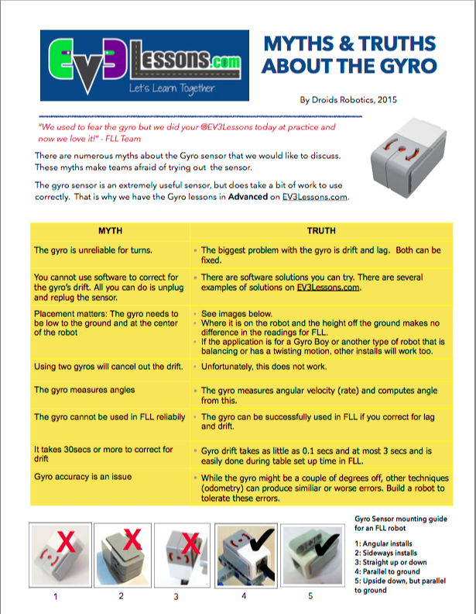
QUICK GUIDES
Hardware | Programming | Documentation & Strategy
Cable Management 1 Cable Management 2 FLL Robot Build Guide Shielding Techniques Using Gears with the EV3 Passive Attachments Carabiner LEGO Digital Designer File One Way Gate LEGO Digital Designer File | One Minute Line Follower Using Sensors: Move Until Improving Robot Reliability Color Sensor: Shielding and Calibration My Blocks Myths & Truths About the Gyro Truth About Turns: Pivot Turns | Using Comments to Improve Code Engineering Notebook LEGO CAD & Robot Build Instructions Robot Game Strategy Mission Planning Worksheet Learning FLL Runs
EV3 Platform | Misc.
Edu vs. Home Edition Software EV3 and NXT Compatibility Updating Software/Firmware Home Edition Updating Software/Firmware Edu Edition | LEGO Organization Systems Roles and Responsibilities Tournament Checklist Ten Off-Season Ideas FLL: Getting Started Guide
http://ev3lessons.com/guides.html

Slide 8
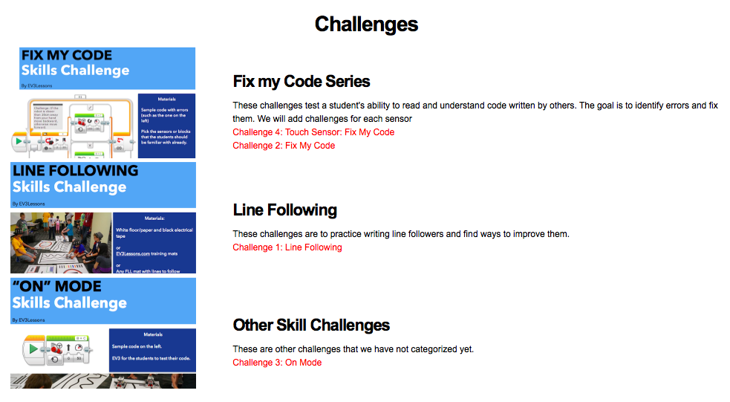
Skills Challenges
http://ev3lessons.com/challenges.html

Slide 9
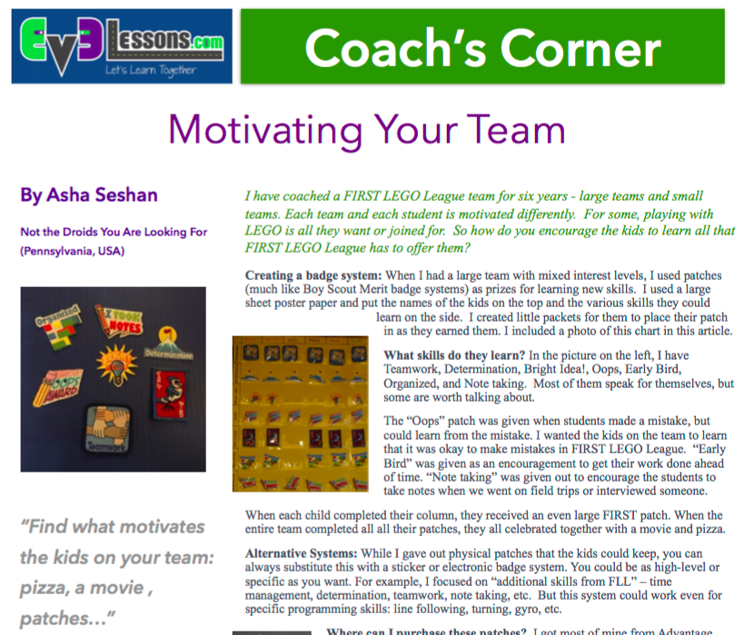
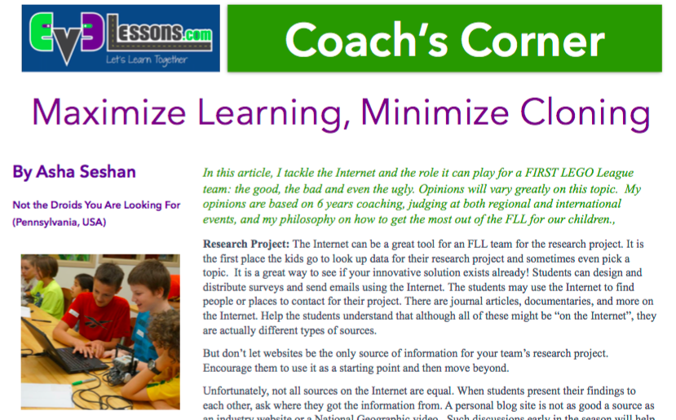
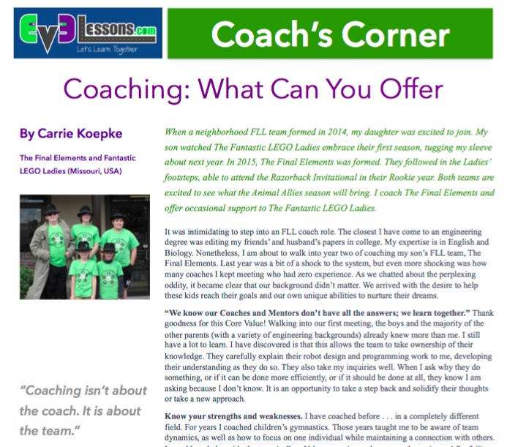
Resources: Coach’s Corner

Slide 10
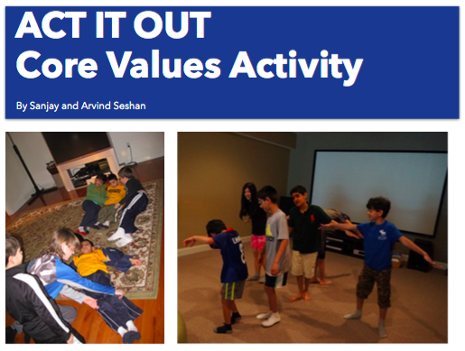
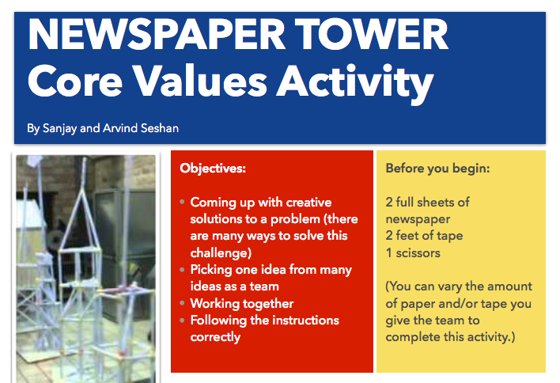
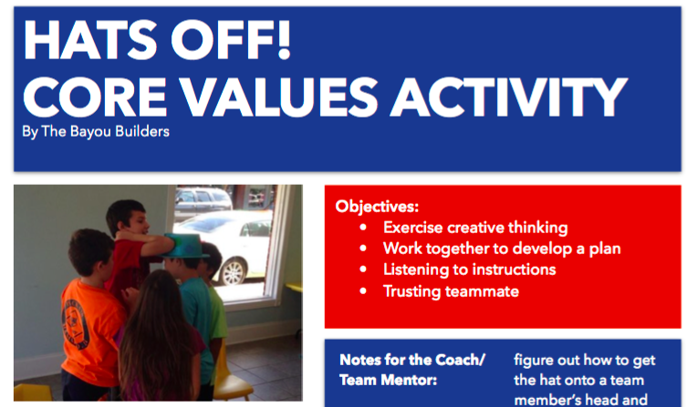
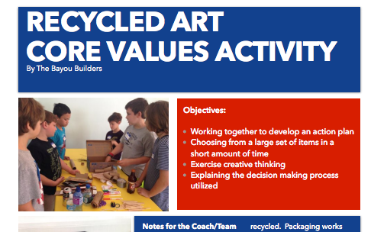
RESOURCES: CORE VALUES ACTIVITIES

Slide 11
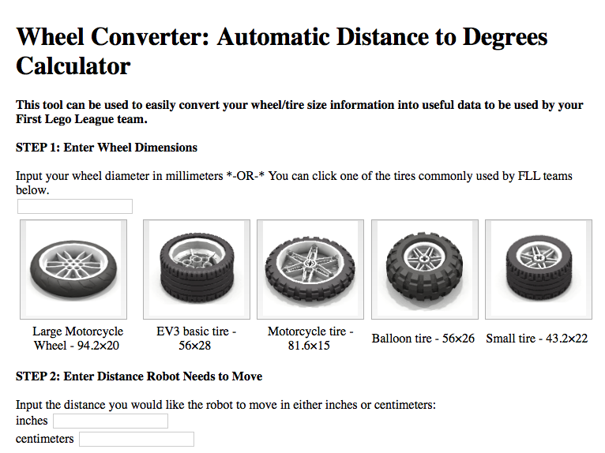
RESOURCES: PLANNING & SCORING TOOLS
Will be updated for Animal Allies
Also available on Apple App Store and Google Play

Slide 12
CREDITS
Author: Sanjay and Arvind Seshan
More lessons are available at www.ev3lessons.com
This work is licensed under a Creative Commons Attribution-NonCommercial-ShareAlike 4.0 International License.

